Slide 1

FitQuest
by Chet Gurevitch, Christina Garcia, Alexa McGinnis, Elian Renteria, Nelly Sanchez

Slide 2
App Description & Demo
Features:
Step Counter
Run Log
Weight Training Log
Exercise Alarm + Notification
Water Intake Log
Calorie Counter

Slide 3
Exercises – Step Counter
Android Concepts:
Permissions
android.Manifest.permission.ACTIVITY_RECOGNITION.
Access step counter sensor
Recycler View
Displays and manages a dynamic user step history list efficiently
Firebase
Stores and updates user step data in real-time with Firebase Firestore.
ViewModel
Manage data operations and updates UI with current information.
Fragment
Modular, reusable component
Challenges:
Steps resetting on a new day
Foreground Service
Not implemented in final version due to time constraints

Slide 4
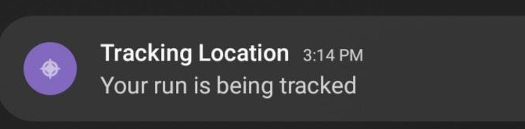
Exercises – Run Tracker
Android Concepts:
Permissions
Coarse, fine, background locations
foreground service
foreground service location
Recycler View
Displays and manages a dynamic user run history
Firebase
Stores and updates user run data with Firebase Firestore.
Fragment
Modular, reusable component
Notification
Foreground Service Notification
Challenges:
Track while app is in background
Foreground Service
Broadcasting data accurately

Slide 5
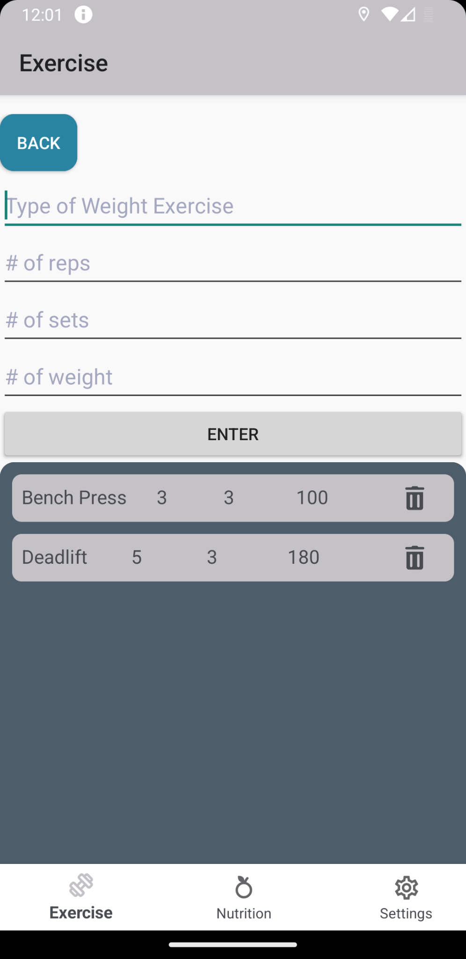
Exercises - Weight Training Log
Recycler View
Displays the weight training exercises in a list after the enter button is clicked.
The list will constantly update.
Fragment
modular

Slide 6
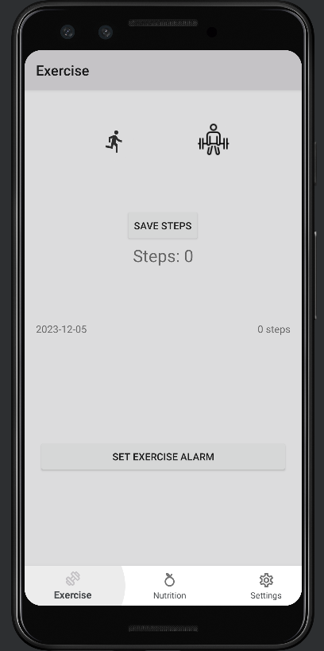
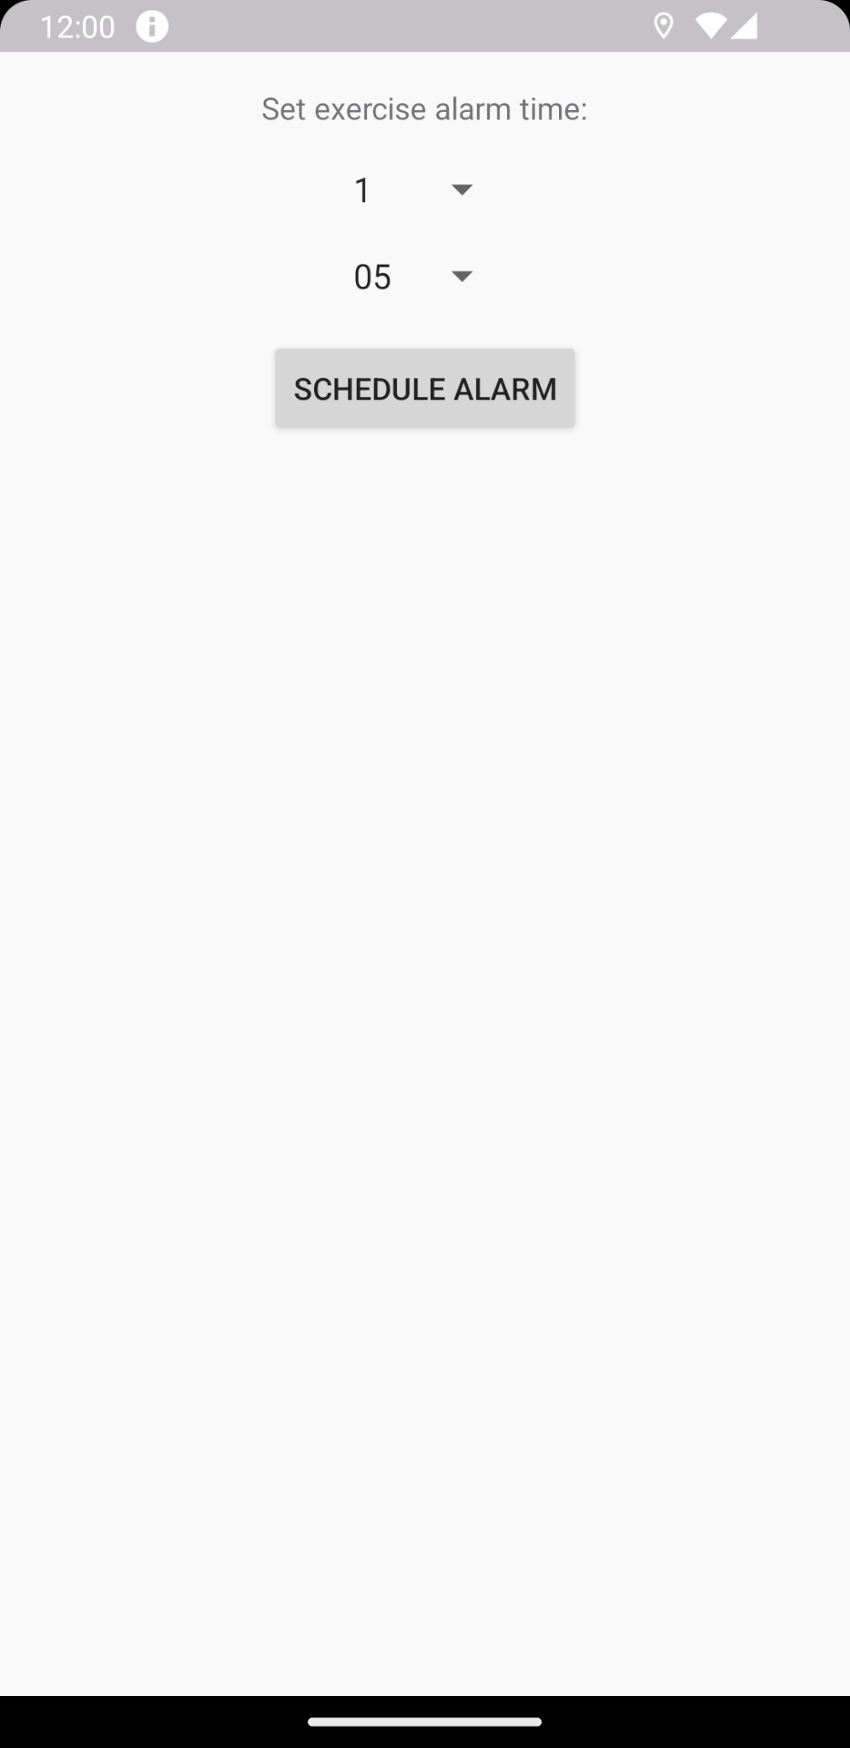
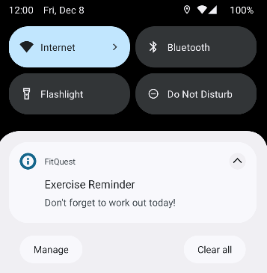
Exercise Reminder Alarm + Notification
Activity
Handles user interaction with alarm setter
BroadcastReceiver
Receive, create, & show the alarm notification
UI
Button, TextView, Spinners,
Challenges
Connecting the new activity, alarm, & ui components with the existing code

Slide 7
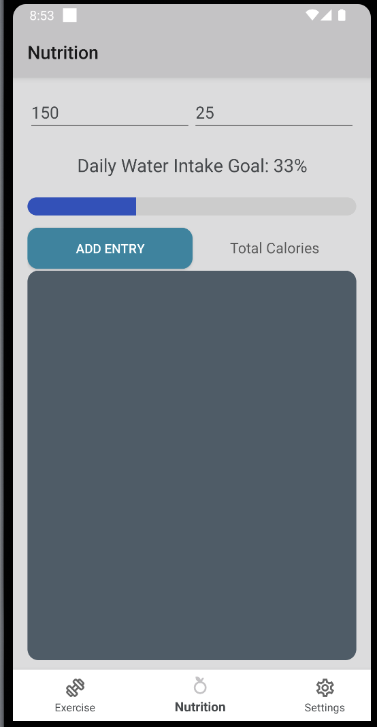
Water Intake Progress Bar
Android Concepts:
RecyclerView
Food and calories get displayed in a list
UI Elements
Buttons, edit texts, textviews
Challenges:
Formatting
Water intake percentage would go past 100 percent and getting the water bar to animate required a custom component

Slide 8
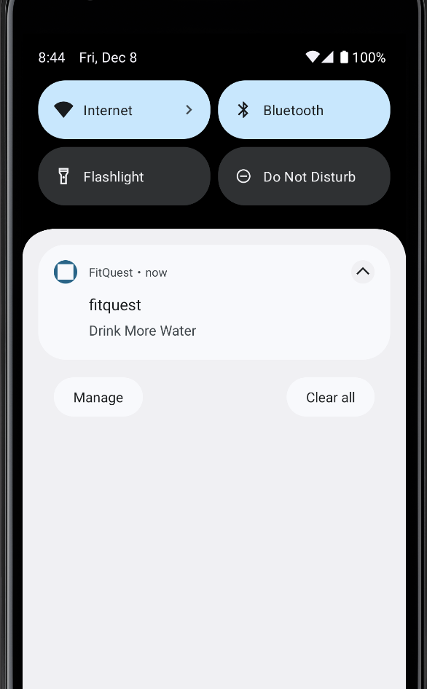
Scheduled Notifications
Android Concepts:
Notifications
Created a alarm component that schedules notifications throughout the day at certain times to remind users to drink water
Challenges:
Creating the Alarm component
Kept track of time and when to send notifications
Permissions
Displaying notifications

Slide 9
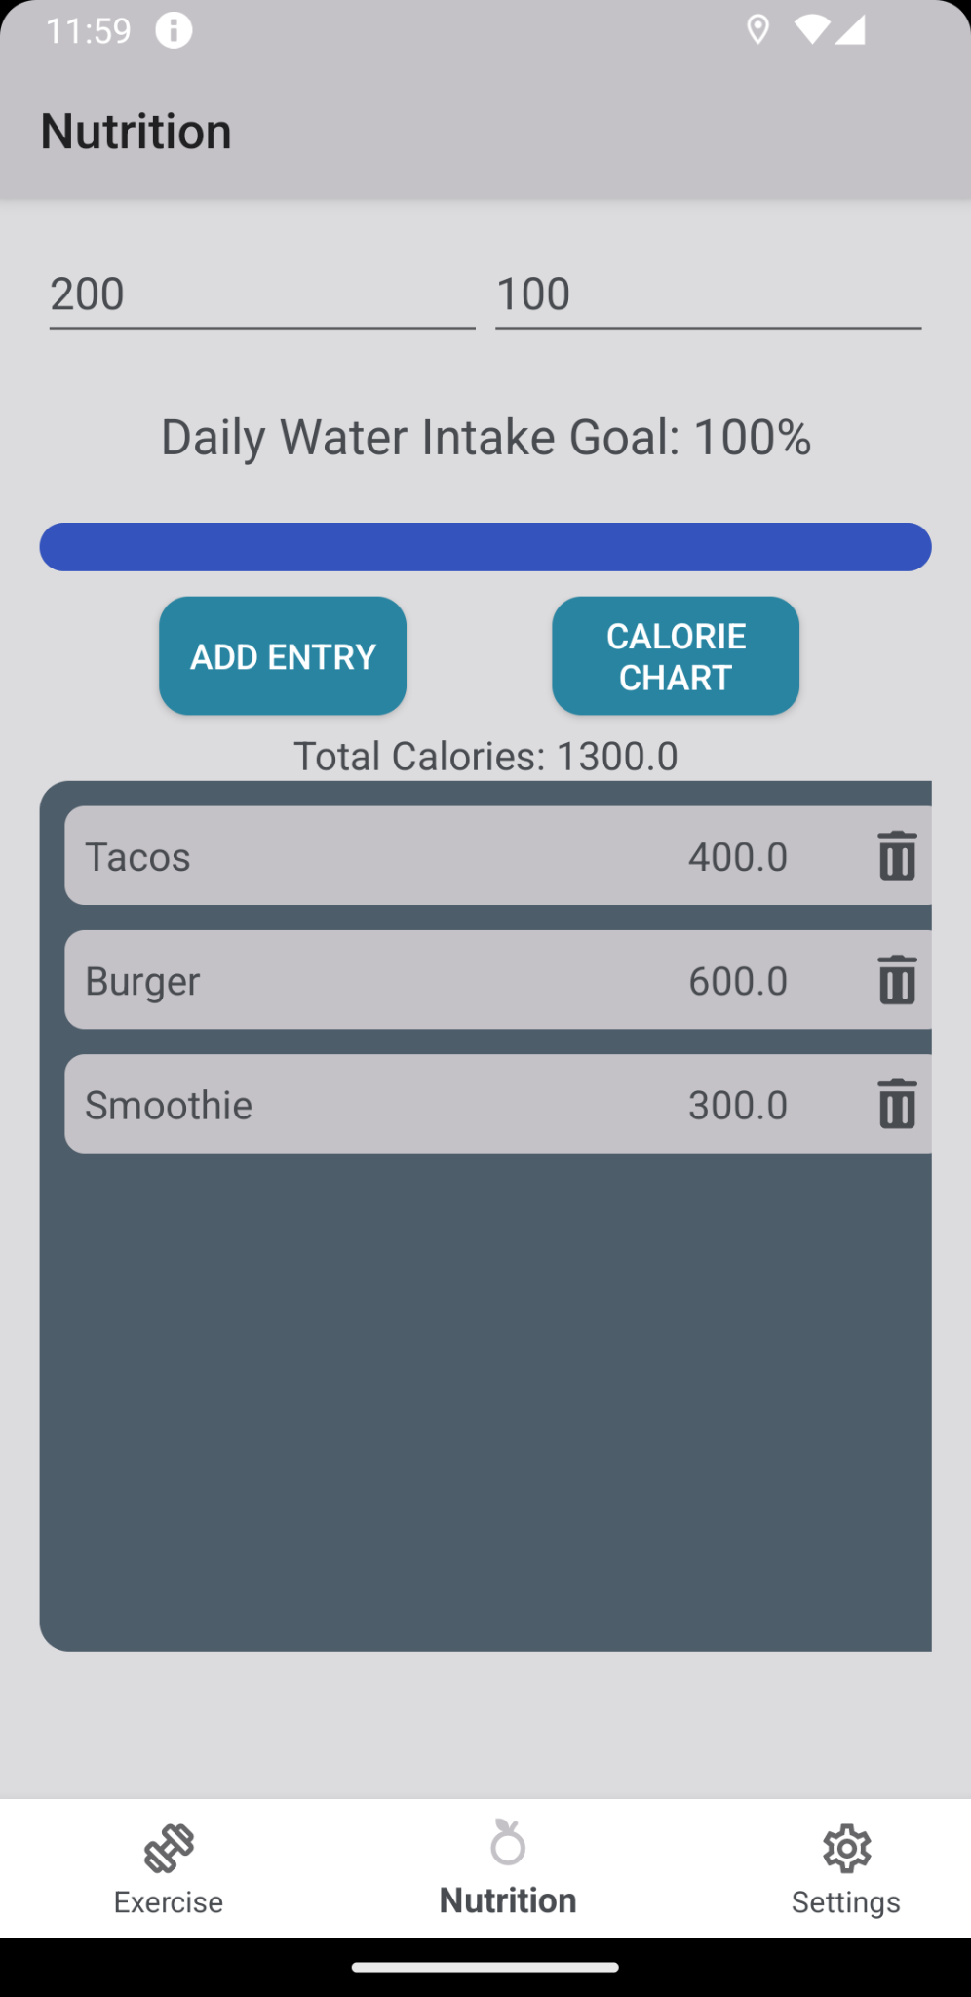
Calorie Counter
Android Concepts:
Activities/Fragments
Modular
RecyclerView
Food and calories get displayed in a list
UI Elements
Buttons, edit texts, textviews
Unit Testing
Calorie calculations
Challenges:
Formatting
When adding the calorie chart button, the other UI elements on this fragment would move around

Slide 10
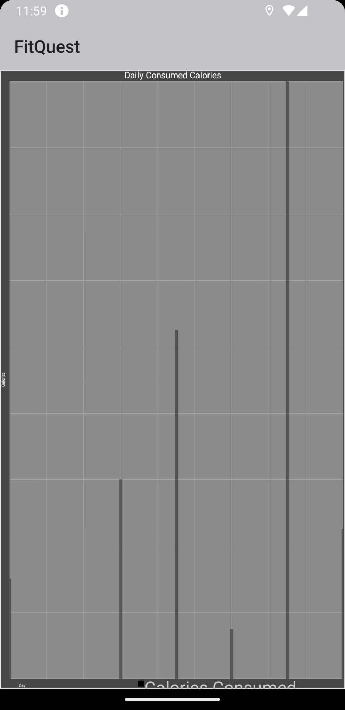
Calorie Counter Chart
Android Concepts:
Chart/Graph
Will chart the daily consumed calories by user
Sample Data
Challenges:
Display
Displaying the graph correctly
Firebase
Due to time constraints, we weren’t able to connect our graph to firebase

Slide 11
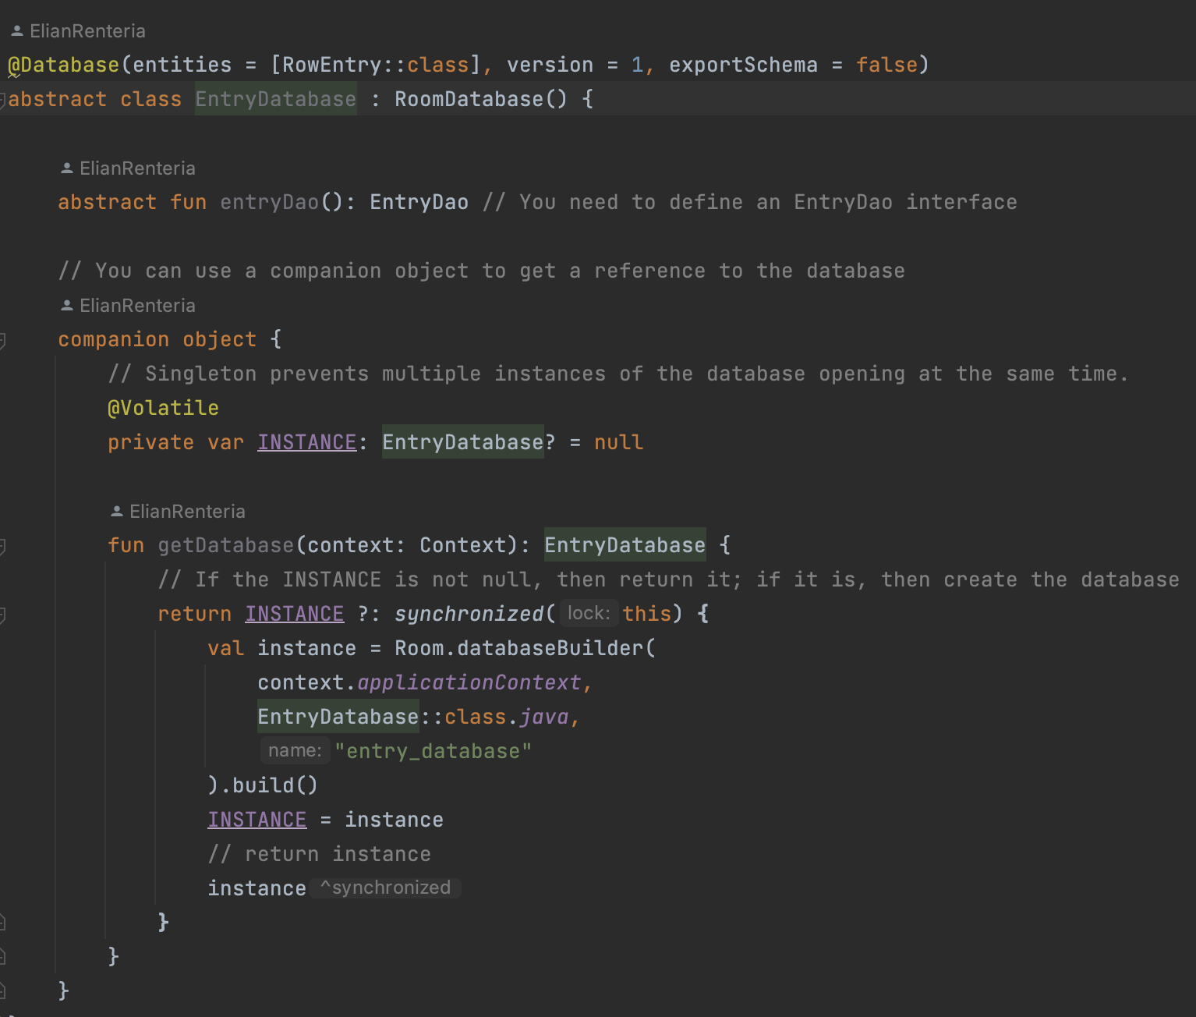
Room Database
Android Concepts:
Room
Used to save calorie counter data across each tab
Challenges:
Setup
Setting up the database and linking each row of the calorie list recycle view
Synchronizing each instance

Slide 12
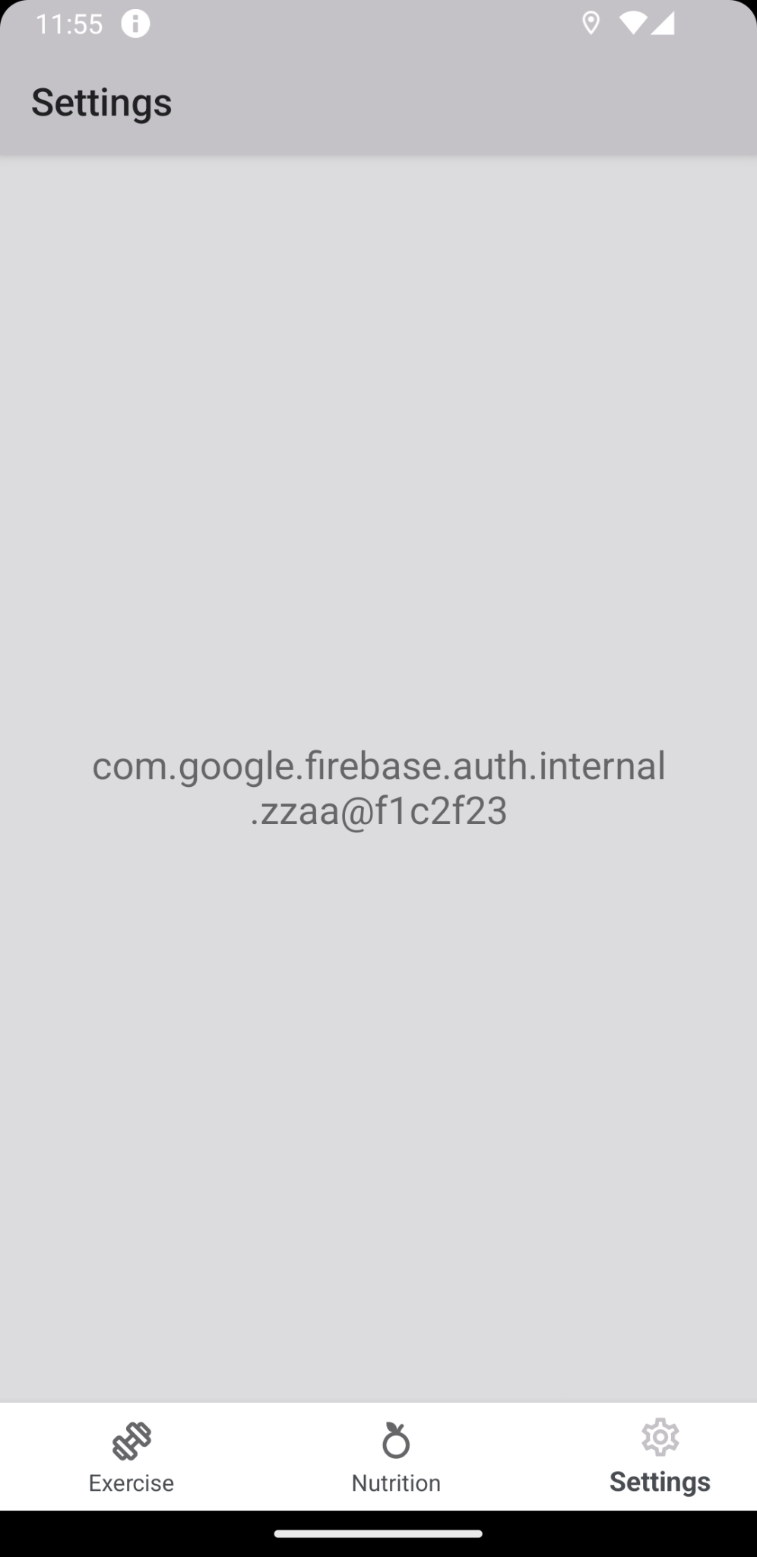
Firebase
Automatic anonymous login
Exercise data backed up to firebase
When more authentication providers added user data will be linked and preserved

